Slide 1

FakeNews
Go-to-Market / Sustainability Proposal
Notes:
This sample serves as a guideline on what should be covered on Go-to-Market / Sustainability Proposal

Slide 2
Intro of your capstone team
Pasrah_Saja ( B21-CAP0431 ) consists of six people - two people from the same university and each path ( Android Developer, Cloud Computing, Machine Learning). Android Developer consist of Muhammad Rizal and Rezi Rahdianor, Cloud Computing consist of Ahmad Farhan Putra Kusuma and Maliki Karim, and lastly from Machine learning path consist of Aditya Tresnobudi and Adrian Timotheus Salim.
In this Capstone Project, we make a mobile app name FakeNews. this mobile app is a Fake News detector or in here we more familiar with hoax news. With this app everyone can cross-check whether a news is relevance or not.

Slide 3
Backgrounder Facts
60 %
of our potential customers are thriving for new solutions

Slide 4
Backgrounder
What are you trying to achieve/solve?
So what we want to solve is that we know that nowadays there is a lot of fake news or what we call hoax news. we really want to solve how everyone can know that what they read in a news is a hoax or not. so that's what we want to achieve with this app
Is there anything been done before?
yes, for the public, someone has made a dataset for this application, but for us, this is the first time we have made it such as a machine learning model and its android application the different from the model that already on public, its mobile app.

Slide 5
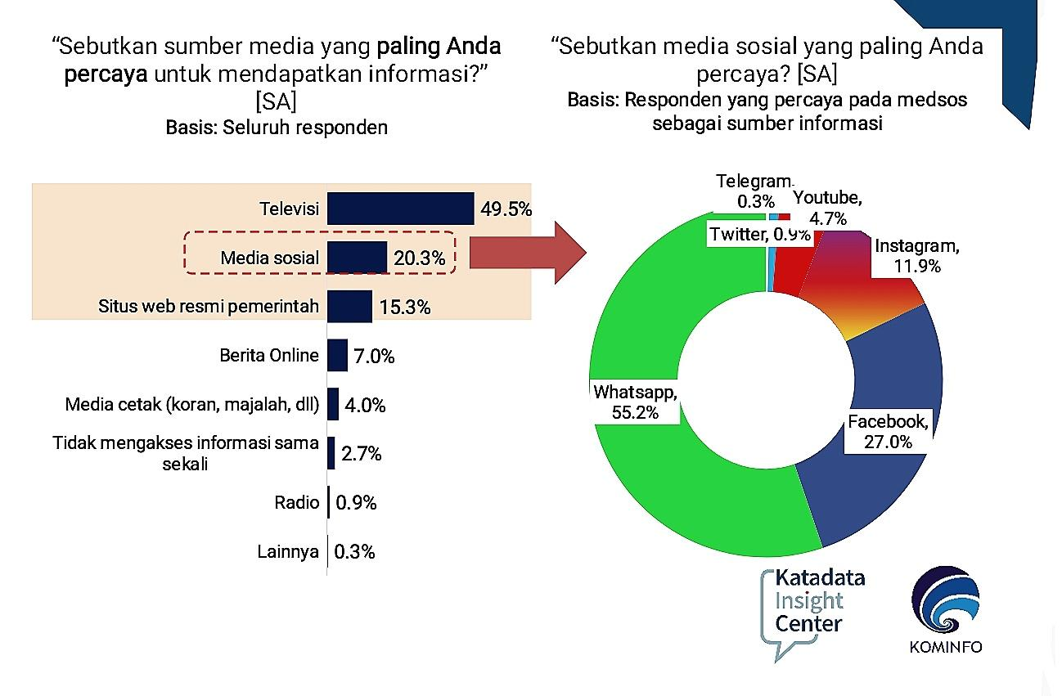
Intro of your capstone project
Why your capstone project is built in the first place?
We made this project because we knew hoax news is a common issue in our society. in 2020 base on KIC Survey 20% of people believe that social media is a relevant place to get information, but there is a lot of websites that provide missed news , so here comes our application to overcome that situation
What are the advantages of your capstone project?
Different from the other’s, our application implemented a mobile app, so its easier to access, and with the machine learning model that we use. we could know the accuracy about news that we want to cross-check

Slide 6
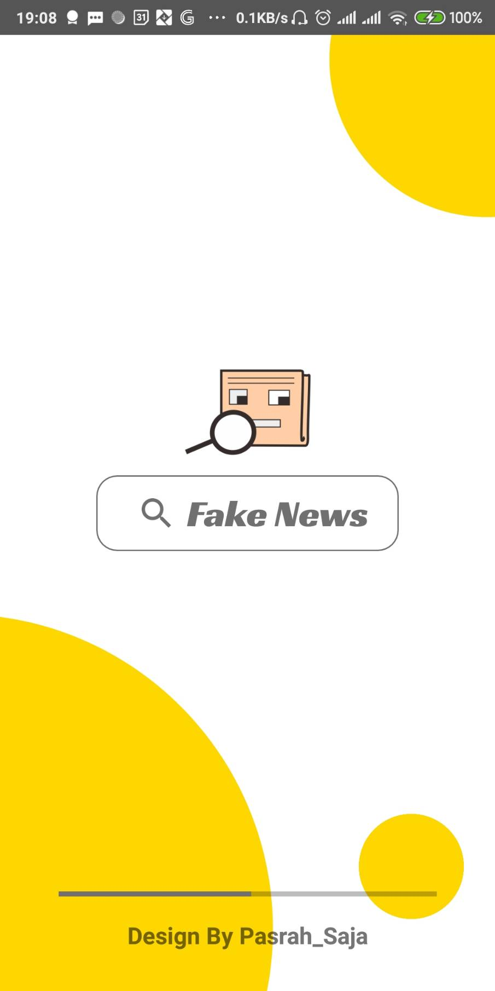
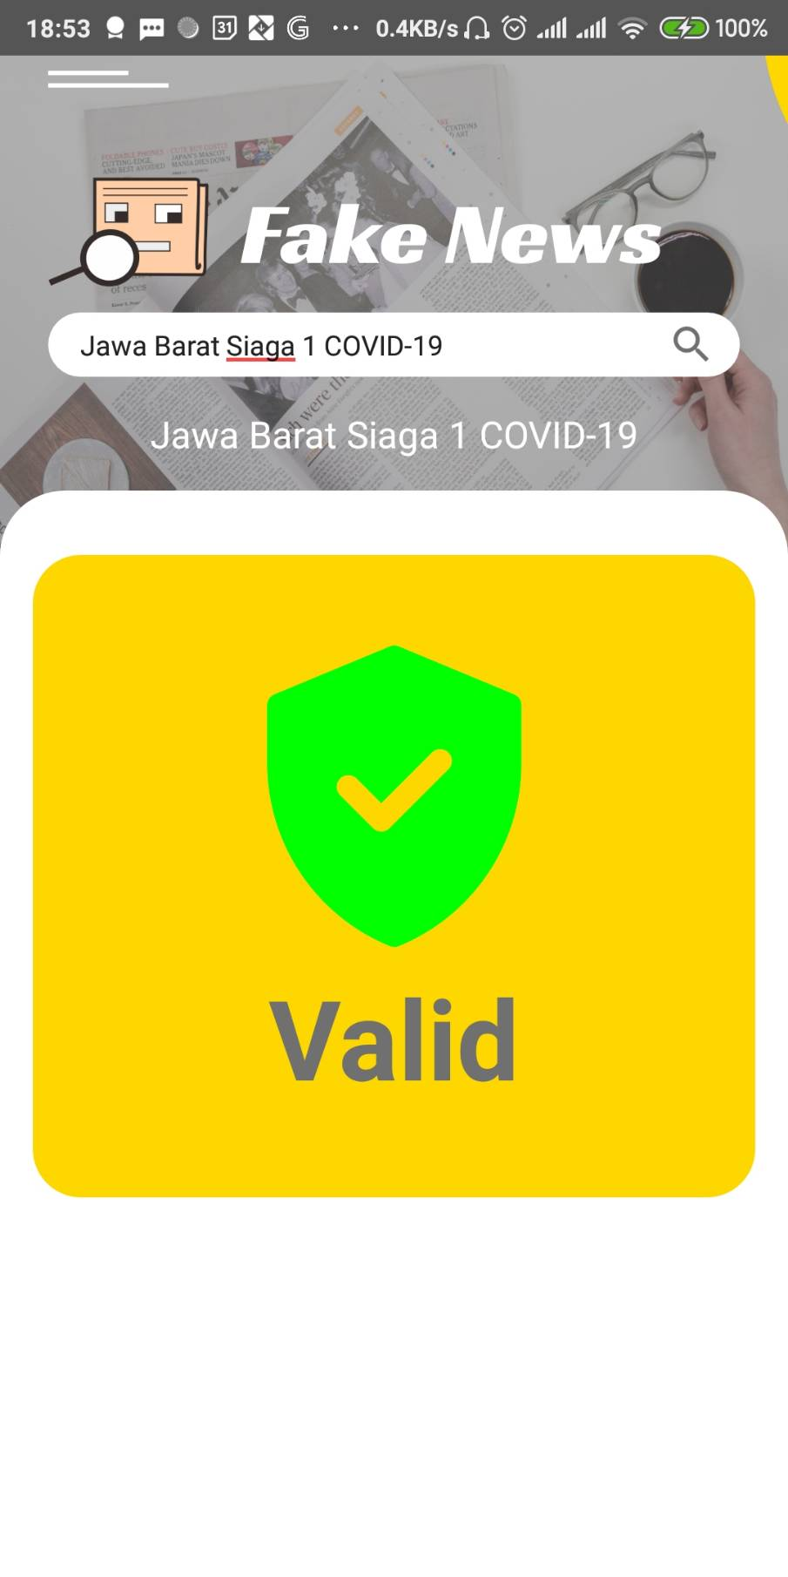
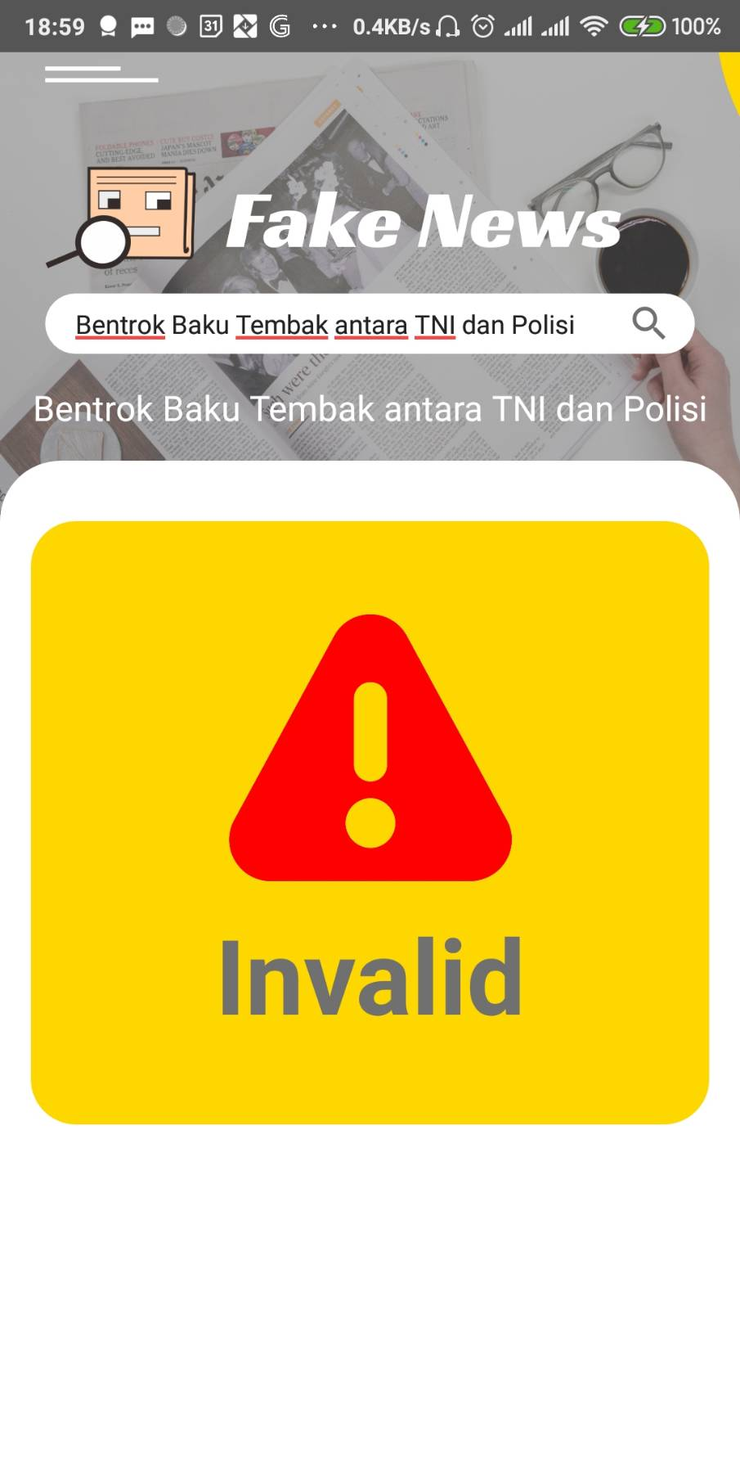
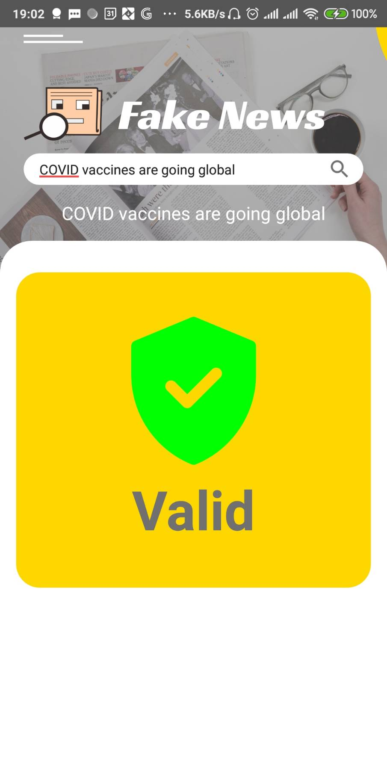
Screenshots of your app

Slide 7

Target Market or Personas
Age range | Profession | Roles | Specific Attributes or likings, hobbies
12 - 22 years old | Students & Collages Student | learning needs | Usually students look for news for their assignment needs to make sure the news is valid or can't use this application
23 - 55 years old | Politician, businessman, etc | looking for valid news | sometimes adults are looking for valid news or not. with this application you can check valid news

Slide 8
Why your target market needs your solution?
Purpose-driven | Data-driven | Government reasoning | Stakeholders related and benefitted from your solutions
Because with this application the target market can better monitor the market with higher accuracy because hoax news can be sorted, for those aged 12-22 they can better educate them about which hoax news and true news | The data we use to train the model that we use for this application is valid and up-to-date data, so it is more relevant to what is happening in the world today, so the news that is sorted can be more accurate and provide true facts. | If hoax news can be minimized, then the economy can move better and help the government to rotate the economy, and of course not only in the economic field, this application can be developed by adding other features that help the government, especially to spread valid news. | Stakeholders can feel more benefits because this application can still be developed in many areas because news is not only limited to business

Slide 9
Comparison to similar services/apps
40 % better
(based on … testing)
Notes:
may

Slide 10
Your Roadmap
Commercial Value
Making people more aware of receiving information on all platforms (digital or conventional)
Business Opportunities
-
Demand & Supplies
-
Technology Advantages
We use machine learning implemented in mobile app so it’s easy to use
Science Breakthroughs
-
Tackling bigger problems in the future
literate public how the important valid information is so that unwanted things don't happen in the future
Benefits for long-term
the creation of a more critical society in the field of information
Indirect effect
With this app, it is hoped that the public will be able to filter the information circulating later
Notes:
Aspects of these roadmap categories must be applied

Slide 11
Project Milestones for 2021
Analysis how user respond to our app and get feedback from it
Integrated our app into bigquery so we can do future analysis from it
July
October
August
December
Fixing the bugs and add feature from feedback we got
Make an update to improve our app

Slide 12
Budgeting - 1 - USD 5k / IDR 70m
Category | Proportions (max) | Budget (max) in USD
Team Salary Android Developer Cloud Computing Machine Learning | 30% | $500 / Rp. 7.500.000 $500 / Rp. 7.500.000 $500 / Rp. 7.500.000
Research / Operational | 70% | $3500 Rp /RP. 50.000.000.000
Buying / Renting Things | 25% | $1250 / Rp 18.000.000
Prototyping | 20% | $1000 / Rp 14.250.000
Learning / Survey / FGD / Data Collections | 20% | $1000 / Rp 14.250.000
Legalities, Patent , Copyright, Registration, and Product Certification | 5% | $250 / Rp 3.500.000
Notes:
See details on: https://kedaireka.id/matchingfund https://kedaireka.id/panduan/panduan_matching_fund.pdf

Slide 13
Budgeting - 2 - USD 10k / IDR 140m
Category | Proportions (max) | Budget (max) in USD
All aspects covered in Budgeting - 1 | 50% | $5.000 / Rp 70.000.000
Additional Budget for Team Salary | 15% | $1.500 / Rp 21.000.000
Additional Budget for Research/Ops | 20% | $2.000/ Rp 28.000.000
Marketing and Sales | 20% | $2.000 / Rp 28.000.000
Market research and competitive analysis | 10% | $1.000 / Rp 14.000.000
Future Development / R&D | 20% | $2.000 / Rp 28.000.000
Other Expenses (taxes, reserves) | 10% | $1.000 / Rp 14.000.000
Notes:
See details on: https://kedaireka.id/matchingfund https://kedaireka.id/panduan/panduan_matching_fund.pdf

Slide 14
Sustainability
Sources of Income
Efficiency Priority
Sales (penjualan): $10k M
Project (proyek): $15k M
Subscription (langganan): $5k M
Grants (hibah): $20k M
Soft Loan (pinjaman): - M
Rounds of Funding (pembiayaan): $10k M
Running with bare-minimum operations
Reducing overhead and unnecessary costs
Reducing travel and miscellaneous expenses
Choose appropriate services and third-party vendors
Notes:
Sample, please modify

Slide 15
Based on the 5k/10k USD Budgeting, expectations are
5K Funding
10K Funding
Expected Runway: 16 months / 1.3 years
Expected Headcount: 6 people
Assets: - patent/copyright
- data
Expected Runway: 24 months / 2years
Expected Headcount: 10 people
Market Positioning: news provider
Assets: - knowledge / trained persons
- data
Notes:
Sample, please modify

